Slide 1


Dimensionality Reduction
Principal Component Analysis

Slide 2
Why reduce dimension?

Slide 3
Why use dimensionality reduction algorithms
Data visualization => Visualize lots of features into a 2-D graph
Reduce Noise => Reduce redundancy in a data

Slide 4
Data Visualisation
Years of experience | Salary
1 | 10 000
2 | 13 000
3 | 13 500
4 | 15 000
5 | 17 000

Slide 5
Data Visualisation
Salary
XP

Slide 6
Data Visualisation
Years of experience | Salary | Age
1 | 10 000 | 25
2 | 13 000 | 27
3 | 13 500 | 32
4 | 15 000 | 29
5 | 17 000 | 35

Slide 7
Data Visualisation
Age
Salary
XP

Slide 8
Data Visualisation
Years of experience | Salary | Age | Children
1 | 10 000 | 25 | 0
2 | 13 000 | 27 | 1
3 | 13 500 | 32 | 2
4 | 15 000 | 29 | 0
5 | 17 000 | 35 | 3

Slide 9

Data Visualisation
Age
Children
Salary
XP

Slide 10
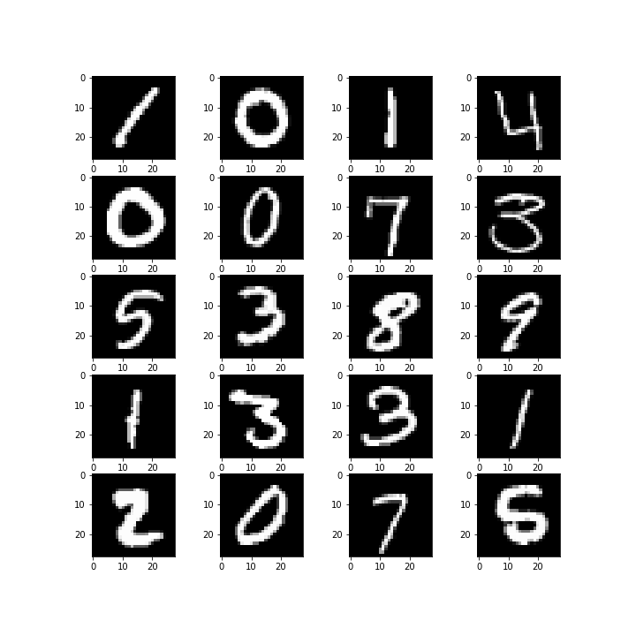
Reduce Noise
Predict Handwritten digits

Slide 11

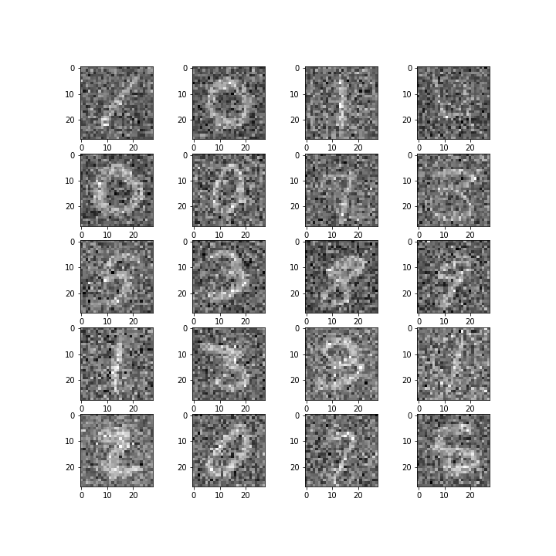
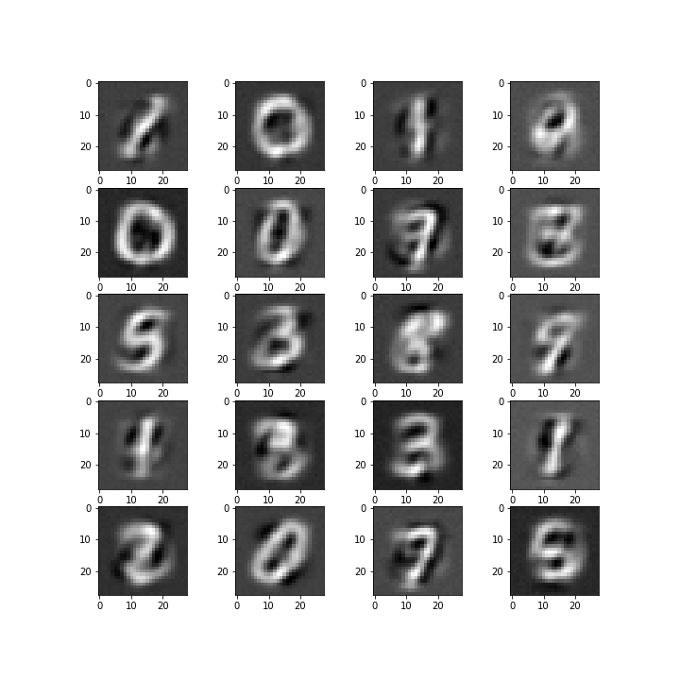
Reduce Noise
PCA

Slide 12
PCA

Slide 13
Why do PCA?
XP | Salary | Age | Children
1 | 10 000 | 25 | 0
2 | 13 000 | 27 | 1
3 | 13 500 | 32 | 2
4 | 15 000 | 29 | 0
5 | 17 000 | 35 | 3
PC1 | PC2
x1 | y1
x2 | y2
x3 | y3
x4 | y4
x5 | y5

Slide 14
How to do PCA?
XP | Salary | Age | Children
1 | 10 000 | 25 | 0
2 | 13 000 | 27 | 1
3 | 13 500 | 32 | 2
4 | 15 000 | 29 | 0
5 | 17 000 | 35 | 3
PC1 | PC2
x1 | y1
x2 | y2
x3 | y3
x4 | y4
x5 | y5

Slide 15
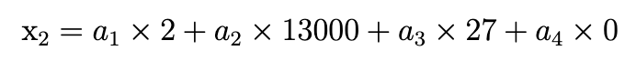
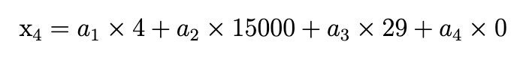
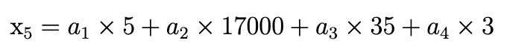
How to do PCA?
XP
Salary
Age
Children

Slide 16
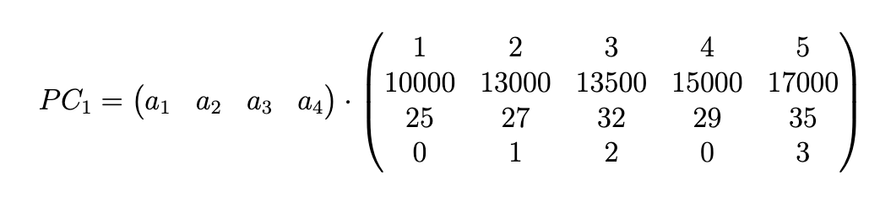
How to do PCA?
This is a dot product

Slide 17
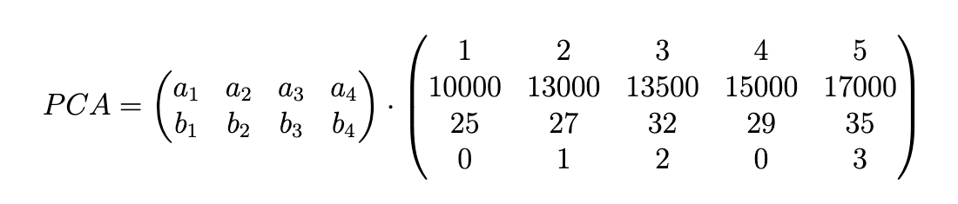
How to do PCA?
Eigen-vector
Eigen-vector
How do we find these?

Slide 18
Process
Normalize X
Calculate Covariance Matrix
Calculate Eigen-vectors & Eigen-values
Deduct PCA
1
2
3
4

Slide 19
Normalize X

Slide 20
Process
Normalize X
Calculate Covariance Matrix
Calculate Eigen-vectors & Eigen-values
Deduct PCA
1
2
3
4

Slide 21
Let’s go back to a simple example
Years of experience | Salary
1 | 10 000
2 | 13 000
3 | 13 500
4 | 15 000
5 | 17 000

Slide 22
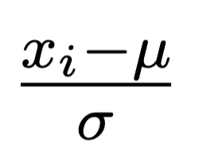
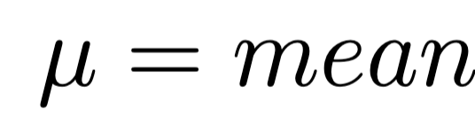
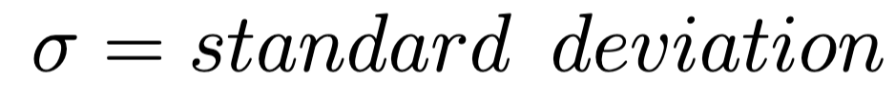
Let’s go back to a simple example
Years of experience | Salary
1 | 10 000
2 | 13 000
3 | 13 500
4 | 15 000
5 | 17 000
Where:

Slide 23
Normalized
Years of experience | Salary
-1.41 | -1.60
-0.71 | -0.30
0 | -0.09
0.71 | 0.56
1.41 | 1.42

Slide 24
Graphically
Salary
XP

Slide 25
Graphically
Salary
XP

Slide 26
Graphically
Salary
Normalization
XP

Slide 27
Calculate Covariance Matrix

Slide 28
Process
Normalize X
Calculate Covariance Matrix
Calculate Eigen-vectors & Eigen-values
Deduct PCA
1
2
3
4

Slide 29
Definitions
Variance => How data points are spread out in a given variable
Covariance => How two variables are related to each other

Slide 30
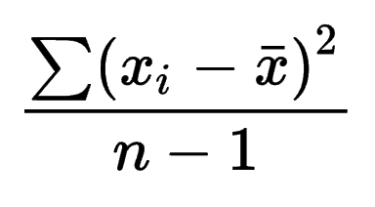
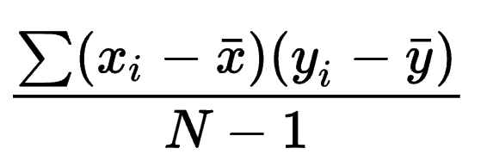
Variance & Covariance
Variance => How data points are spread out in a given variable
Covariance => How two variables are related to each other

Slide 31
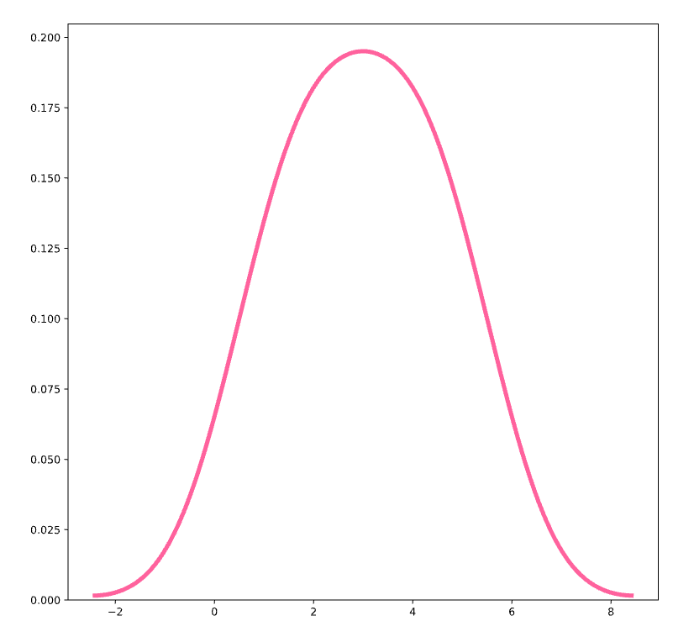
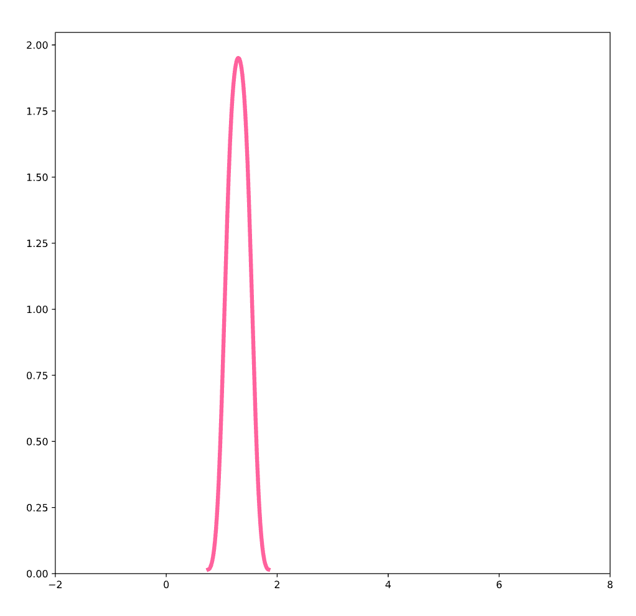
Graphically
High Variance
Low Variance

Slide 32
Let’s calculate covariance matrix
Variance
Covariance
 | XP | Salary
XP | 1.25 | 1.22
Salary | 1.22 | 1.25
Variance
Covariance

Slide 33
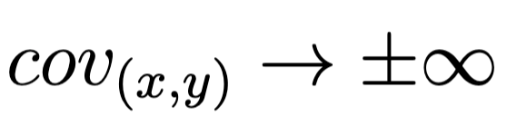
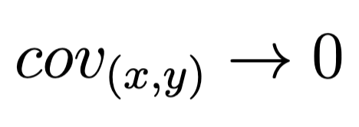
Interpretation
Statistically dependent
Statistically independent

Slide 34
Graphically
Positive Covariance
No Covariance
Negative Covariance

Slide 35
Why using Covariance Matrix?

Slide 36
Process
Normalize X
Calculate Covariance Matrix
Calculate Eigen-vectors & Eigen-values
Deduct PCA
1
2
3
4

Slide 37
Reminder
We want to remove redundancy
We want to decompose our dataset into a smaller dataset

Slide 38
Reminder
Redundancy
Statistically dependent
Statistically independent
No Redundancy

Slide 39
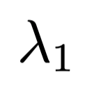
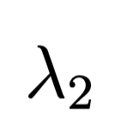
Let’s calculate covariance matrix
Ideal matrix with no redundancy
 | XP | Salary
XP | 1.25 | 1.22
Salary | 1.22 | 1.25
 | XP | Salary
XP |  | 0
Salary | 0

Slide 40
SVD

Slide 41
Process
Normalize X
Calculate Covariance Matrix
Calculate Eigen-vectors & Eigen-values
Deduct PCA
1
2
3
4

Slide 42
Let’s take our dataset back
Years of experience | Salary
-1.41 | -1.60
-0.71 | -0.30
0 | -0.09
0.71 | 0.56
1.41 | 1.42
A

Slide 43
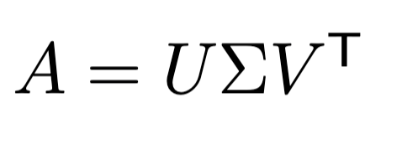

Singular Value Decomposition

Slide 44
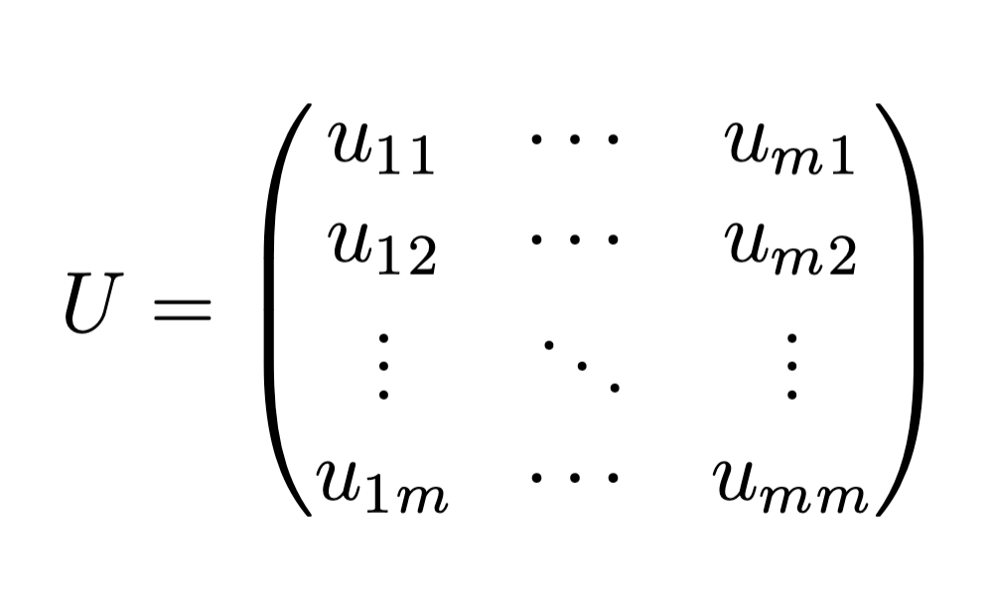
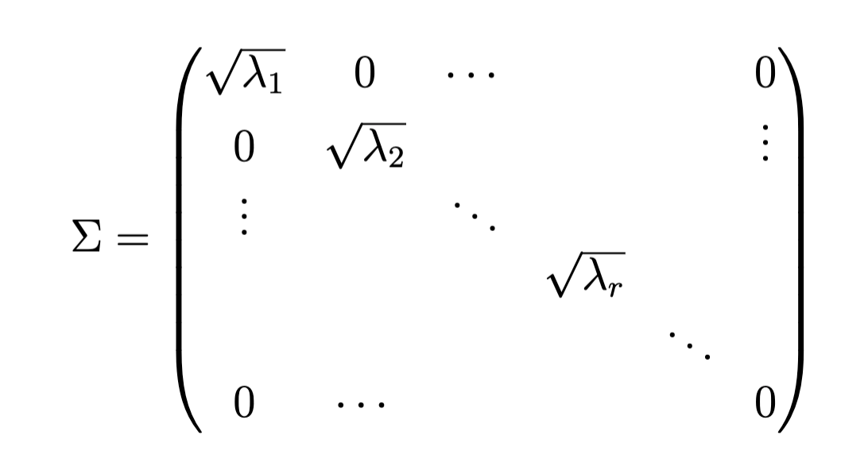
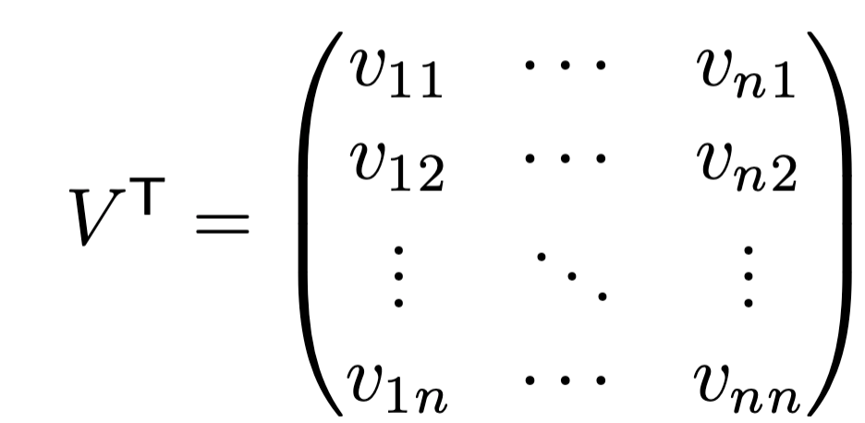
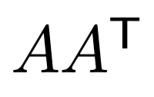
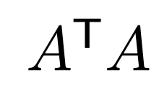
Singular Value Decomposition
Eigen Vectors of
Eigen Values of
and
Eigen Vectors of

Slide 45
Let’s take our example
Years of experience | Salary
-1.41 | -1.60
-0.71 | -0.30
0 | -0.09
0.71 | 0.56
1.41 | 1.42

Slide 46
Let’s take our example
XP | -1.41 | -0.71 | 0 | 0.71 | 1.41
Salary | -1.60 | -0.30 | -0.09 | 0.56 | 1.42
A

Slide 47
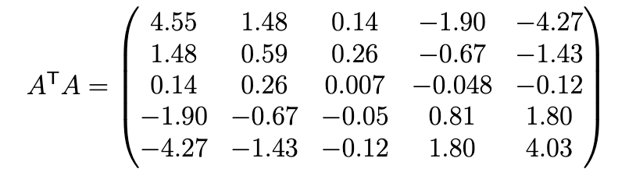
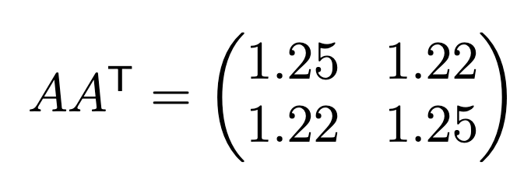
Let’s take our example
Covariance Matrix!!

Slide 48
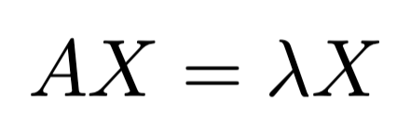
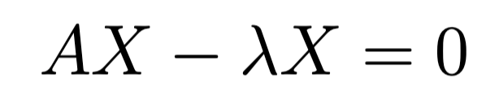
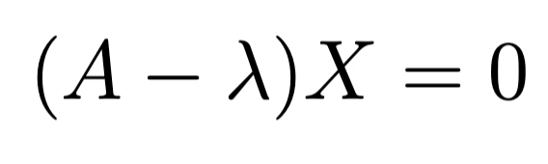
How to find Eigen Vectors & Eigen Values?
Linear Algebra problem - can be solved using Numpy
This is what we can use to find lambda

Slide 49
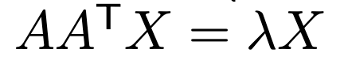
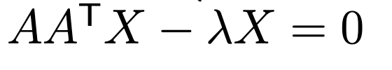
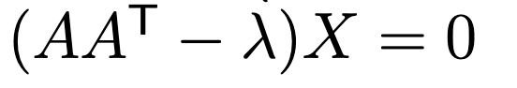
Let’s find Eigen values

Slide 50
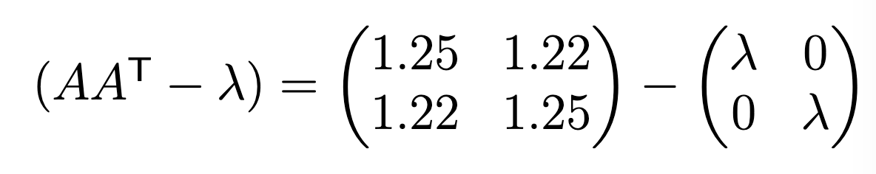
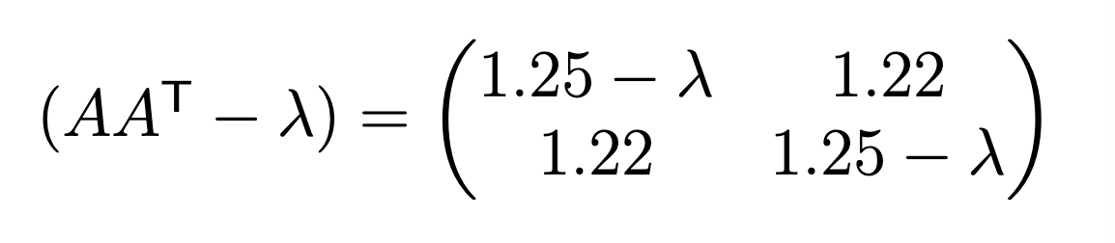
Let’s find Eigen values
Should be equal to 0

Slide 51
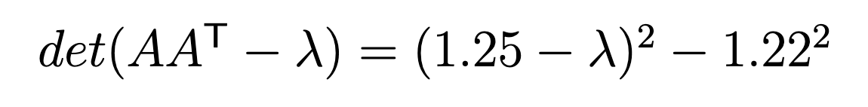
Let’s find Eigen values

Slide 52
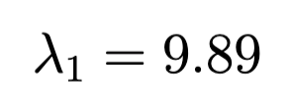
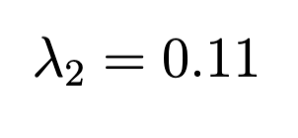
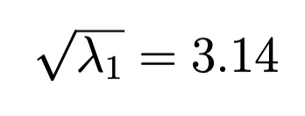
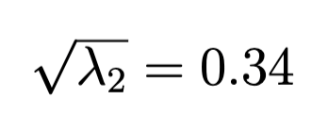
Let’s find Eigen values

Slide 53
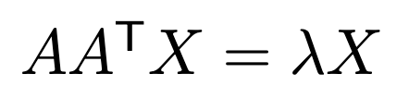
Let’s find Eigen Vectors
Eigen Vectors

Slide 54
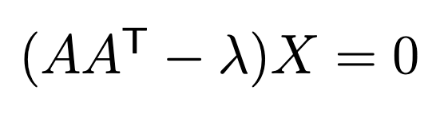
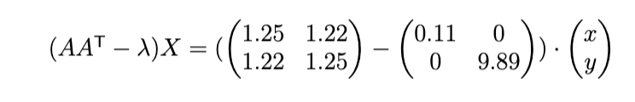
Let’s find Eigen Vectors

Slide 55
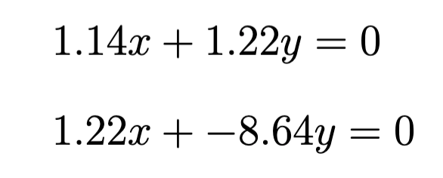
Let’s find Eigen Vectors

Slide 56
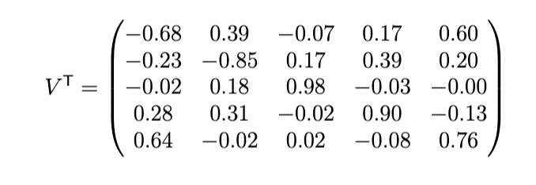
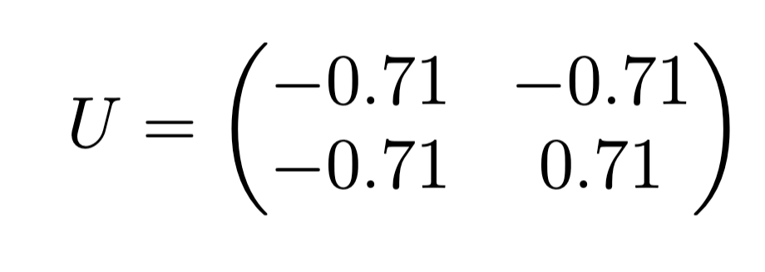
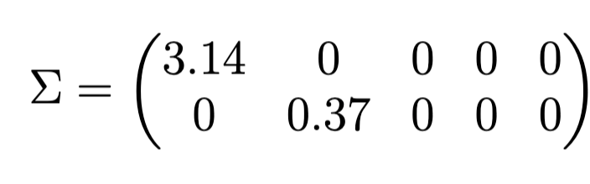
Fast Forward
Eigen-vectors
Eigen-values

Slide 57
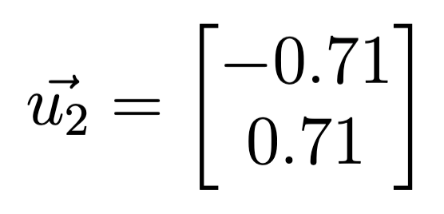
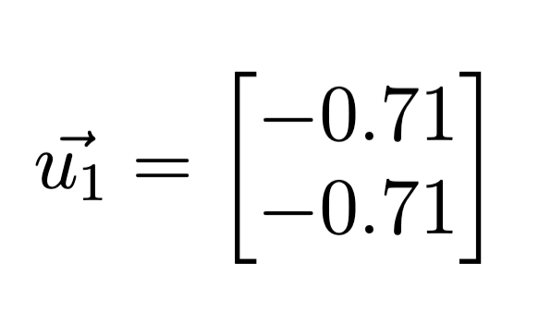
Graphically
Salary
XP

Slide 58
Deduct PCA

Slide 59
Process
Normalize X
Calculate Covariance Matrix
Calculate Eigen-vectors & Eigen-values
Deduct PCA
1
2
3
4

Slide 60
Reminder
Eigen-vectors
Eigen-values

Slide 61
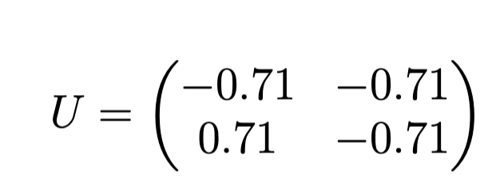
Reminder
Principal Components
Eigen-values

Slide 62

Let’s compute Principal Components

Slide 63

Let’s compute Principal Components

Slide 64


Let’s check our new covariance
 | PC1 | PC2
PC1 | 2.47 | 0
PC2 | 0 | 0.03
No Redundancies!!

Slide 65
How to reduce dimension?
 | PC1 | PC2
PC1 | 2.47 | 0
PC2 | 0 | 0.03
 | PC1 | PC2
PC1 | 99% | 0
PC2 | 0 | 0.1%
Variance explained
Variance explained ratio

Slide 66
How to reduce dimension?
 | PC1 | PC2
PC1 | 2.47 | 0
PC2 | 0 | 0.03
 | PC1 | PC2
PC1 | 99% | 0
PC2 | 0 | 0.1%
We can keep only PC1 !

Slide 67
Graphically
Salary
XP

Slide 68
Graphically

Slide 69
Graphically
PC2
PC1

Slide 70
Graphically
PC2
PC1

Slide 71
Graphically
PC2
Not necessary
PC1

Slide 72

Graphically
PC1

Slide 73

Thanks!
See you in the next course

